Slide 1
Detection and Identification of Pool Balls using Computer Vision
Simon Have & Jesper Bækdahl

Slide 2
Agenda
Introduction
Human Interaction Detection
Ball Detection
Ball Identification
Test and Conclusion

Slide 3
Introduction
System overview:

Slide 4
Human interaction detection
Why detection?
Inclined to be ”paranoid”.
False postive
Type I
False negative
Type II

Slide 5
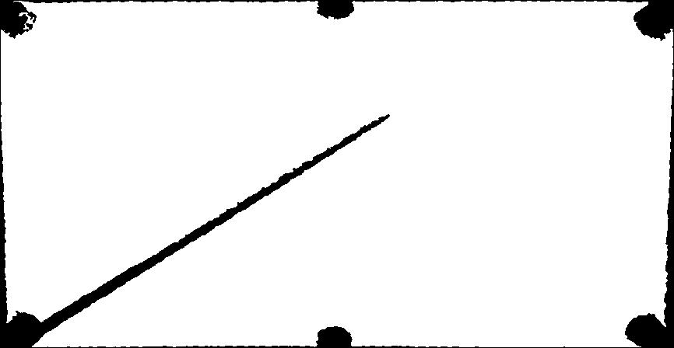
Human interaction detection
Occlusion factors:
Area and Perimeter.

Slide 6
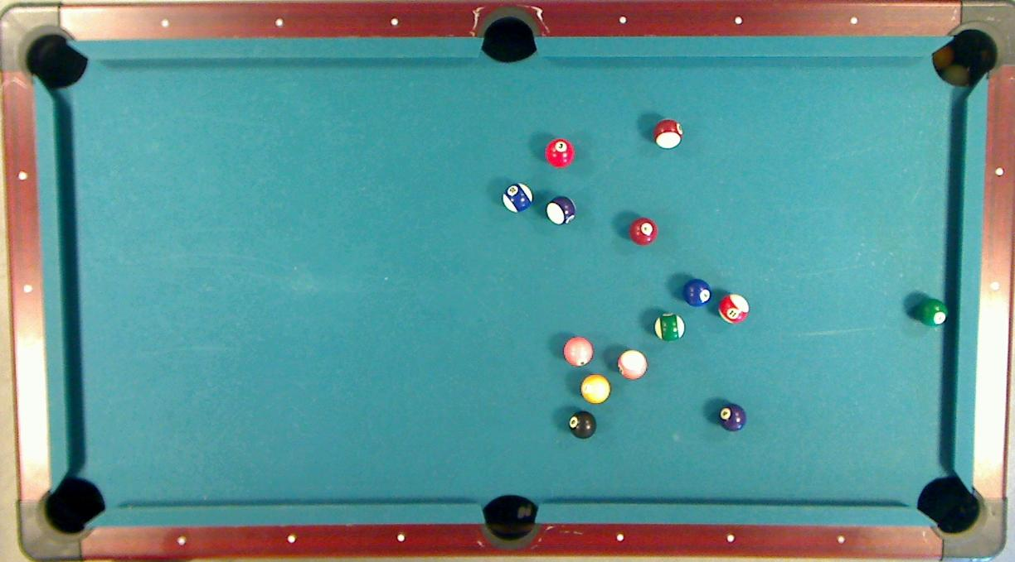

Slide 7
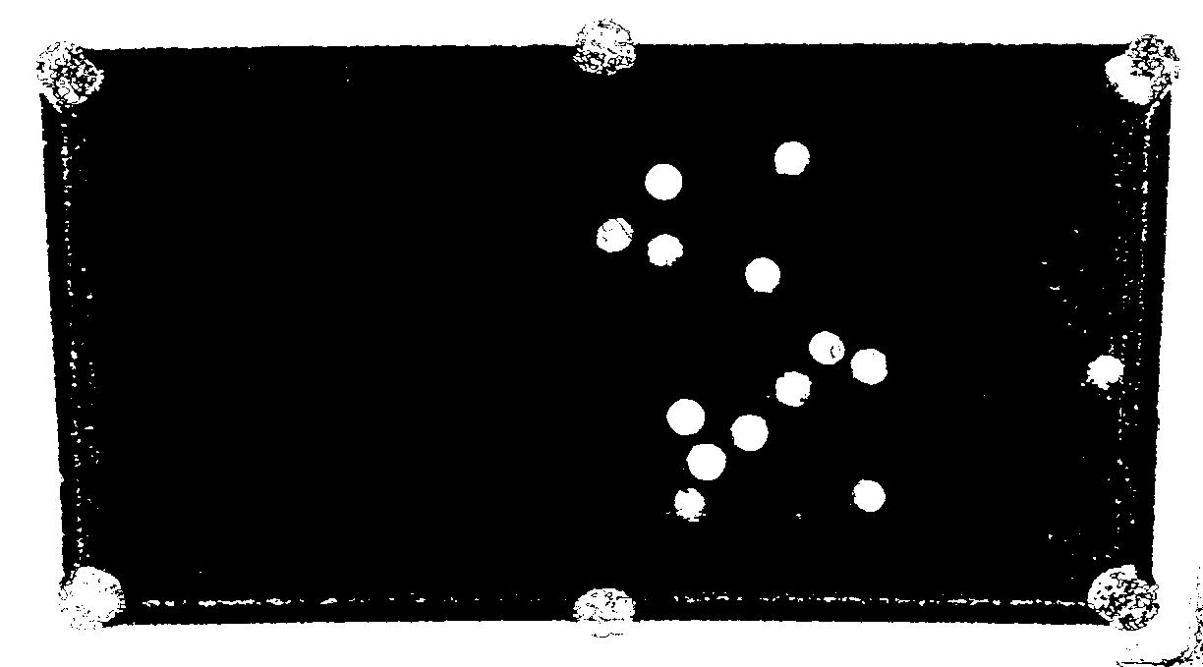
Ball Detection – Preliminary segmentation

Slide 8
Ball Detection – Probability estimation
24%
93%

Slide 9
Ball Detection – Best Candidates Selection
96%
98%

Slide 10
Ball Detection

Slide 11
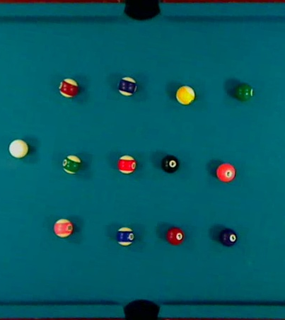
Ball identification - Calibration
Select Balls
Compute mean RGB

Slide 12
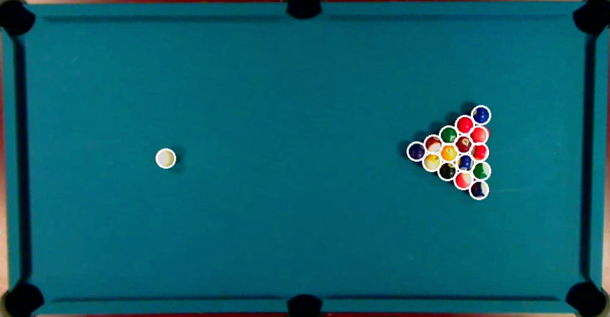
Ball Identification -

